Slide 1
Predicting Therapy Needs in the Tech Community
CSCI 635: Final Project
TEAM - 12
Shravani Athkuri (sa3182)

Slide 2
Motivation
Recognition of the pressing concern for mental health.
Delve into complexities and predict therapy needs.
Aiming to contribute insights for a healthier work environment.
Rapid evolution in the tech industry impacts professionals' well-being.

Slide 3
Introduction
Fast-paced tech industry and its impact on mental well-being.
Research focus on predicting mental health treatment needs.
Exploration of key factors: work environment, familial influences, awareness of resources, and demographic patterns.
Problem Statement: Predicting mental health treatment needs in the tech industry by identifying the key features that impact mental health and building a predictive model.

Slide 4
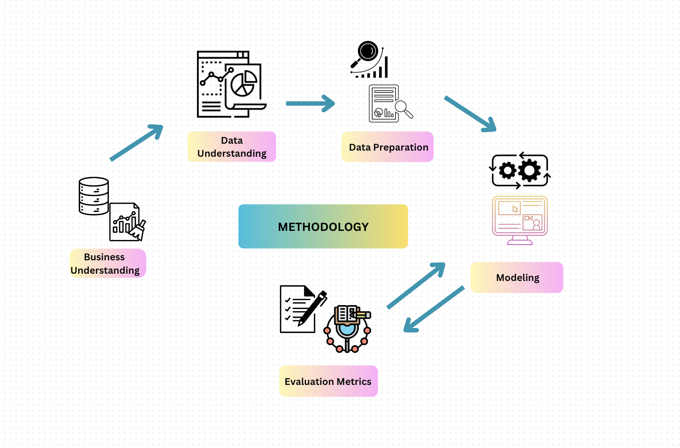
Methodology
Business Understanding
Data Understanding
Data Preparation
Modeling
Evaluation Metrics

Slide 5
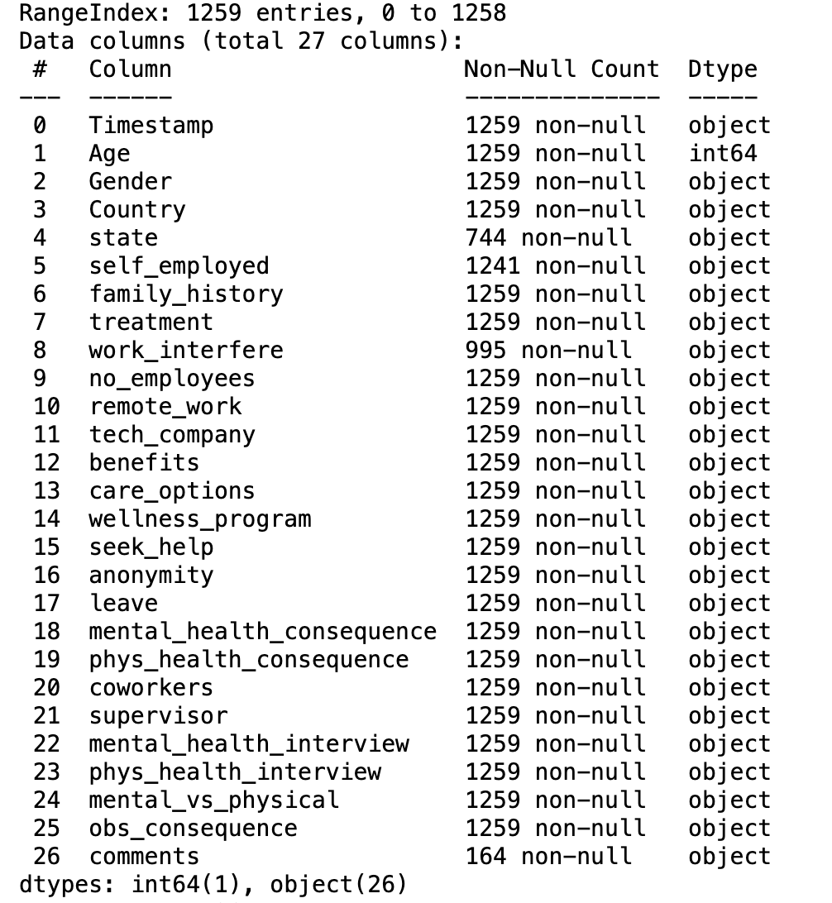
Data Understanding
The OSMI real-time survey data from Tech Professionals
The dataset comprises of 1259 rows x 27 columns
The features primarily include the demographic factors, mental well being programs, family background and work culture

Slide 6
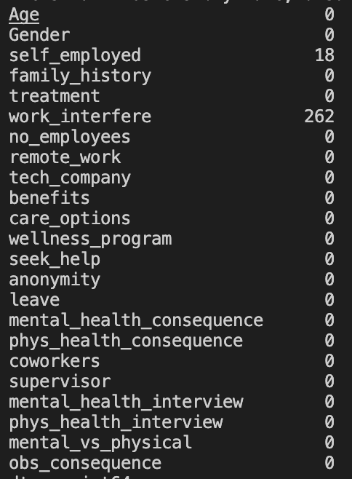
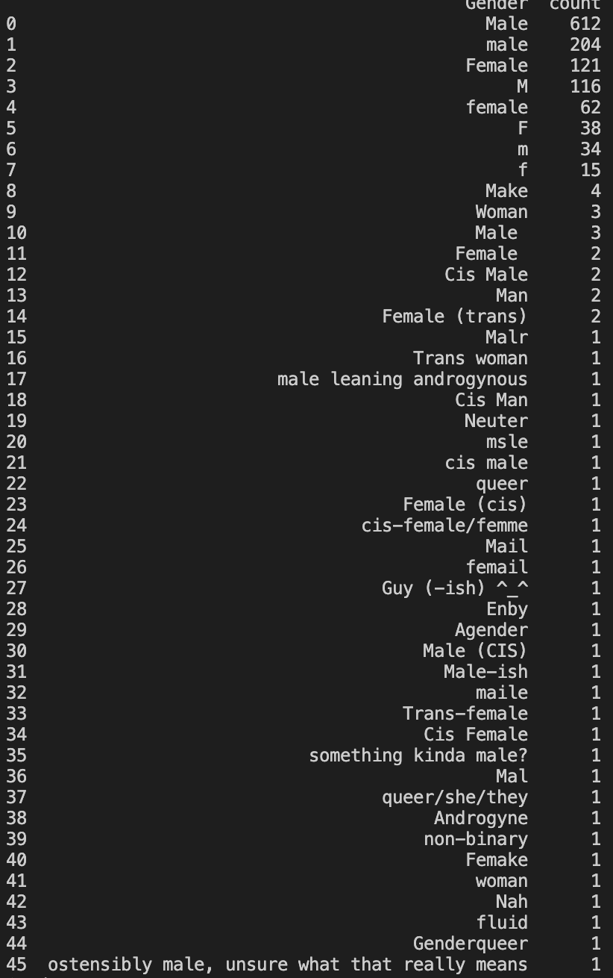
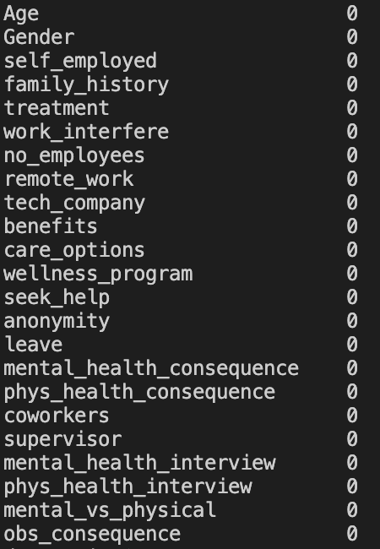
Data Preparation
Data Cleaning
Handling Missing values and Null Values
Improving Data Quality
Age column has negative values and values greater than 100 which is in appropriate.
Gender Feature Standardization
Feature Selection

Slide 7
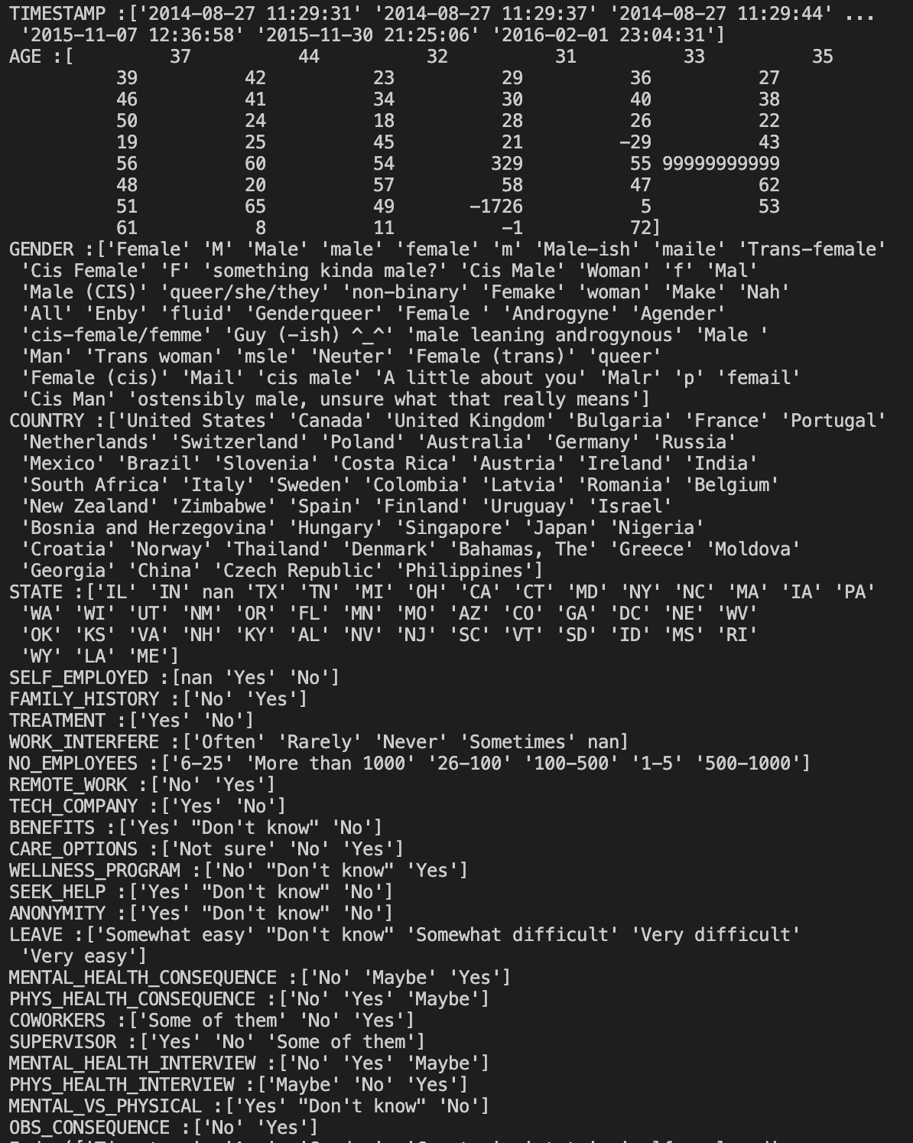
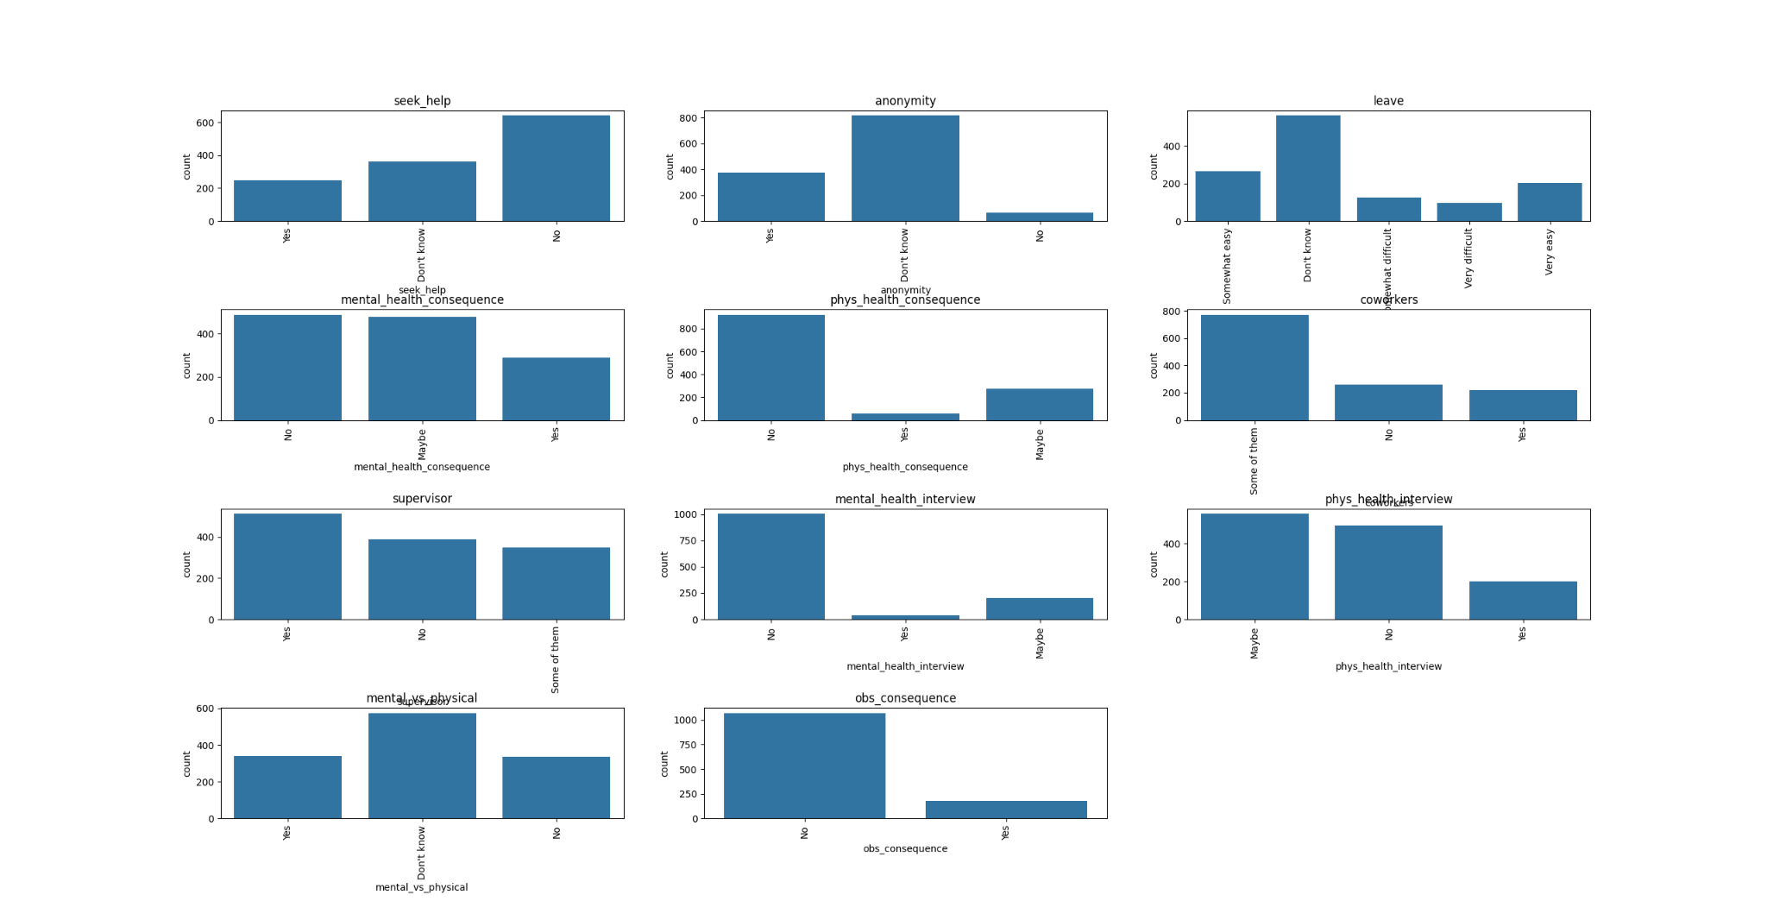
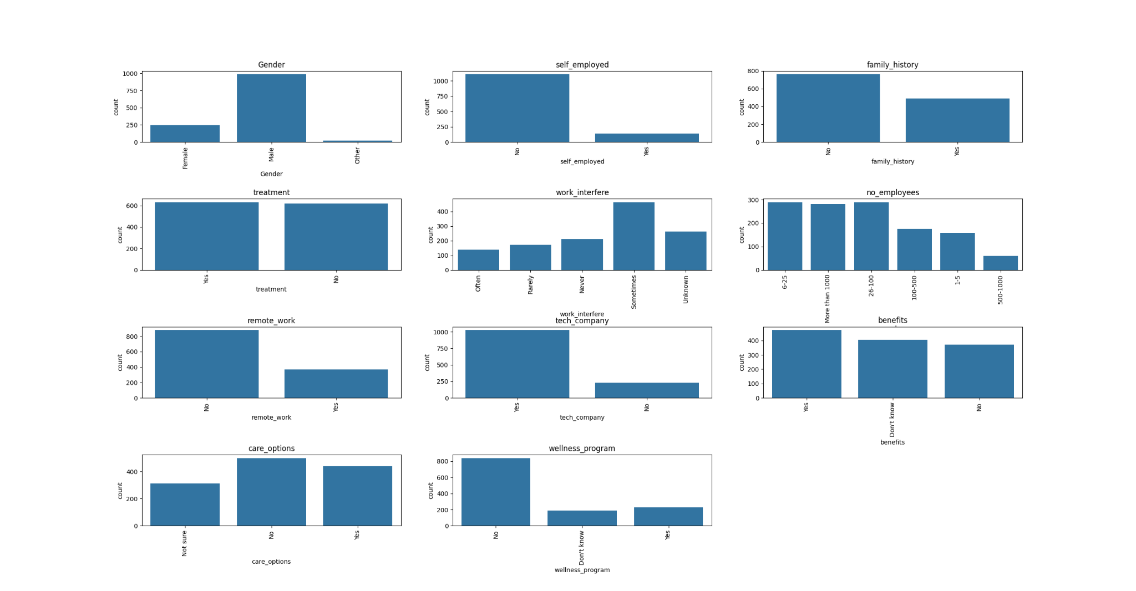
Data Preparation
Exploring the categorical values before and after optimization

Slide 8
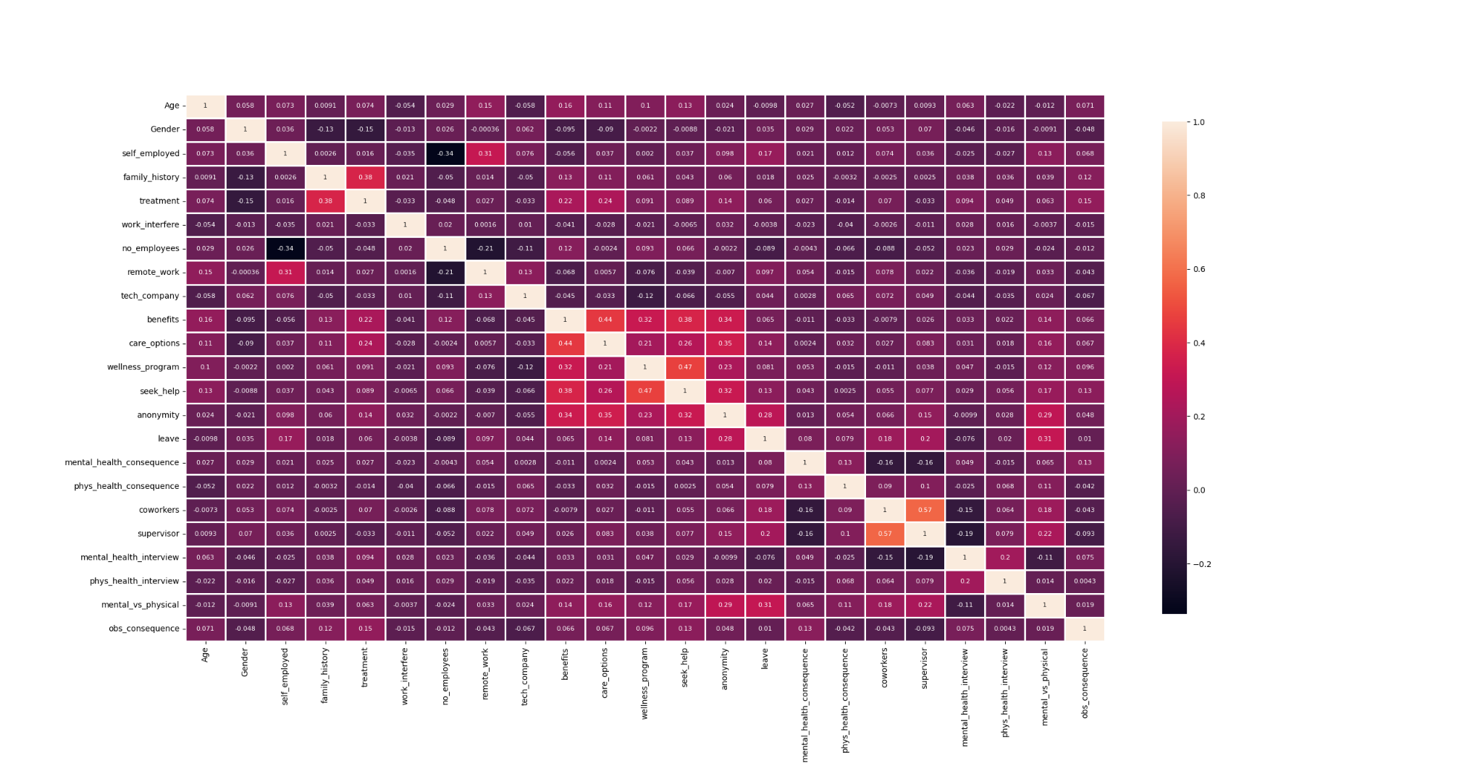
Data Preparation
Label Encoding
Normalization
Understanding the Correlation among features using heat map

Slide 9
Modeling and Evaluation Strategy
Splitting the data
Dependent feature - treatment
Independent features - All other column apart from treatment
Train and Test segments with a test size of 0.2
Modelling Toolkit
Logistic Regression
Decision Tree
Random Forest Classifier
K Neighbors Classifier
GaussianNB
AdaBoost Classifier
XGBoost Classifier
Evaluation Metrics
Accuracy
Precision
Recall
Confusion Matrix
AUC ROC

Slide 10
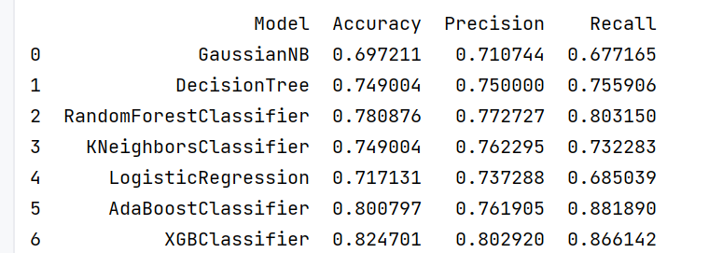
Outcomes
The XGB Classifier emerges as the top-performing model, attaining an impressive accuracy of 82.47%. It excels in both precision 80.29% and recall 86.61%

Slide 11
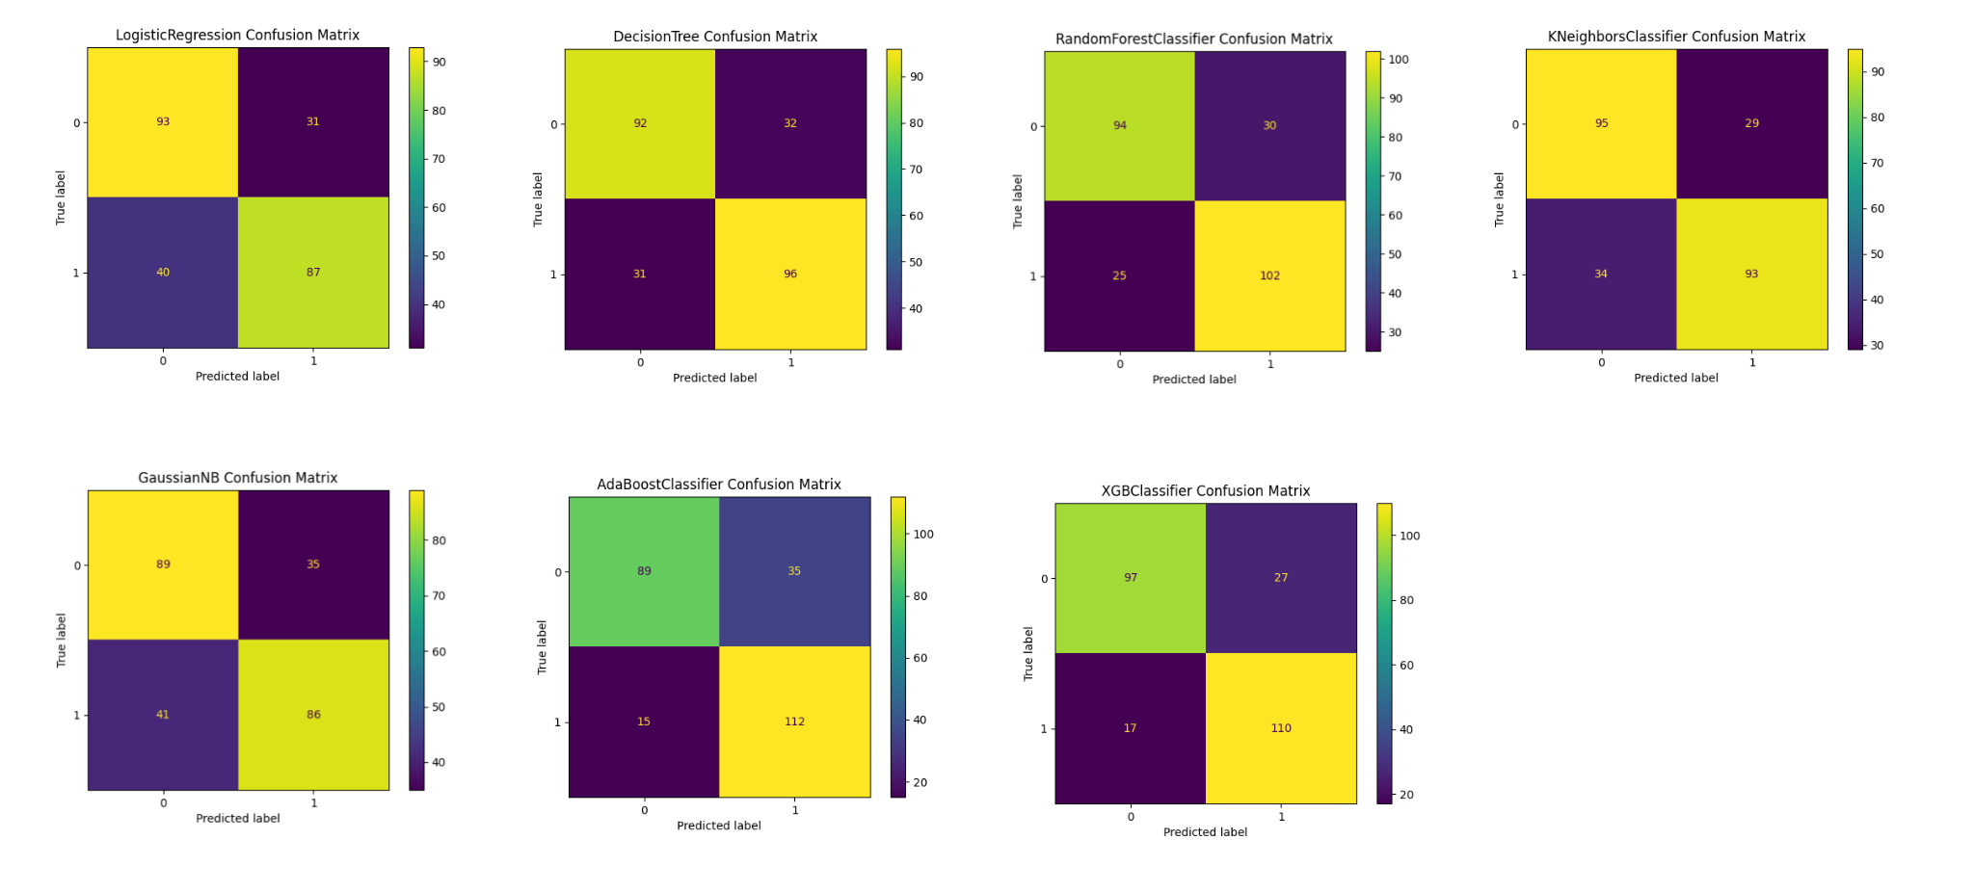
Outcomes
Confusion matrix representing the True and Predicted Labels for each model

Slide 12
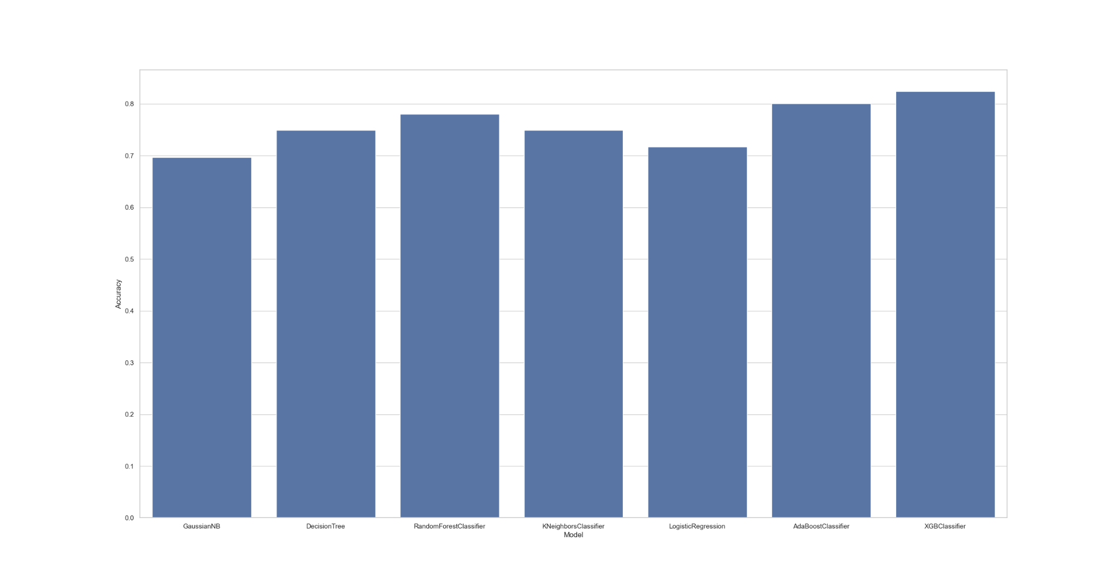
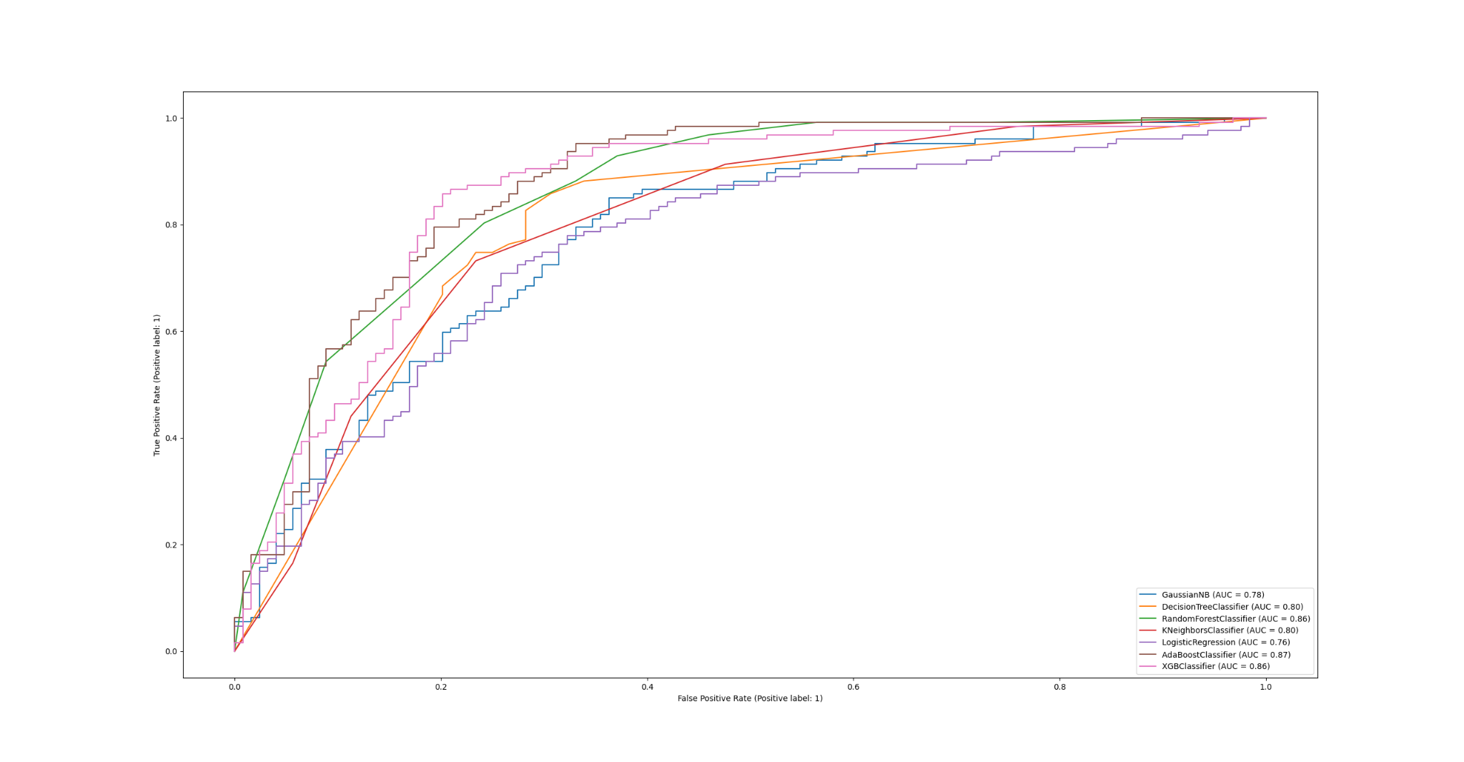
Outcomes
Bar Graph Representing the accuracies of each model
AUC ROC Curve for each predictive model

Slide 13
Future Improvements
Eliminate potential bias in survey during data collection.
Reduce Static and potentially incomplete nature of data.
Ensure Feature set encompass all influential factors.
Diversify data sources beyond surveys.
Implement natural language processing (NLP) techniques to extract richer insights.
Develop personalized interventions.
Establish continuous model evaluation and adaptation with change in factor at Tech community.

Slide 14
Thank You !!!

